Slide 1
Memory Management

Slide 2
Background
Program must be brought (from disk) into memory and placed within a process for it to be run
Main memory and registers are only storage CPU can access directly
CPU fetches instructions from memory according to the value of the program counter.
Instruction-execution cycle
Registers that are built into the CPU are generally accessible within one cycle of the CPU clock. Most CPU scan decode instructions and perform simple operations on register contents at the rate of one or more operations per clock tick.

Slide 3
For proper system operation we must protect the operating system from access by user processes.
On multiuser systems, we must additionally protect user processes from one another.
We first need to make sure that each process has a separate memory space.
To separate memory spaces, we need the ability to determine the range of legal addresses that the process may access and to ensure that the process can access only these legal addresses.
Base Registers
Limit Registers

Slide 4
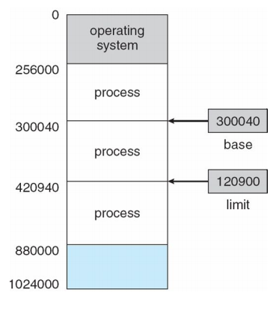
Base and Limit Registers
A pair of base and limit registers define the logical address space .
The base register->holds the smallest legal physical memory address
The limit register-> specifies the size of the range.

Slide 5
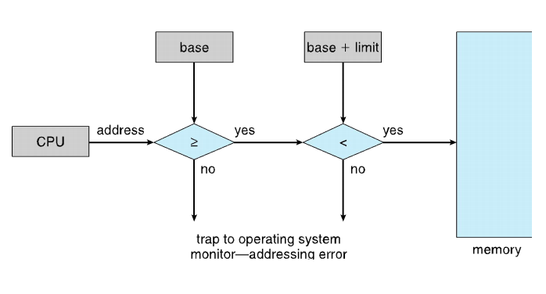
Hardware Address Protection
Protection of memory space->accomplished by having the CPU hardware compare every address generated in user mode with the registers.
Privileged instructions can be executed only in kernel mode
since only the operating system executes in kernel mode
only the operating system can load the base and limit registers.

Slide 6
Address Binding
Address binding is a technique of generating addresses to the instruction of programs.
Further, addresses represented in different ways at different stages of a program’s life

Slide 7
Binding of Instructions and Data to Memory
Address binding of instructions and data to memory addresses can happen at three different stages
Compile time
Load time
Execution time

Slide 8
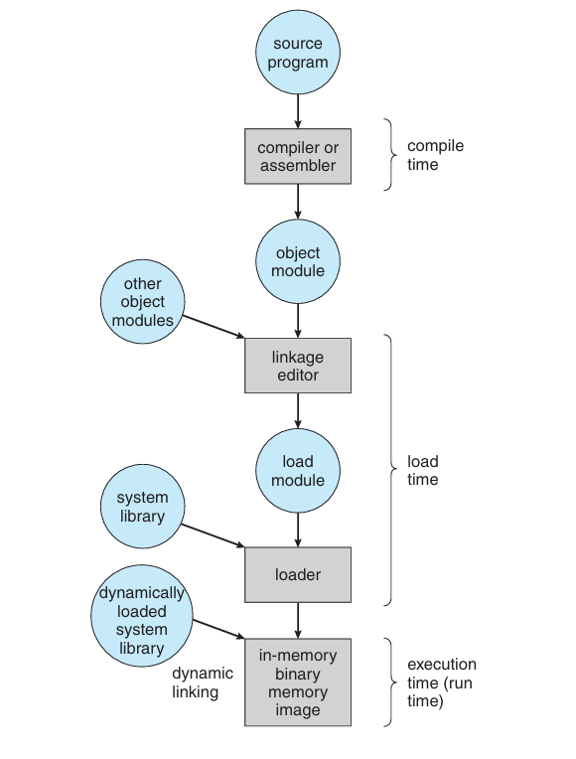
Multistep Processing of a User Program

Slide 9
Logical vs. Physical Address Space
Logical address :
By the CPU; also referred to as virtual address
Physical address:
Address seen by the memory unit
Logical address space:
The set of all logical addresses generated by a program
Physical address space:
The set of all physical addresses generated by a program

Slide 10
Memory-Management Unit (MMU)
Hardware device that at run time maps virtual to physical address are
For simplicity, Base register now called relocation register
The value in the relocation register is added to every address generated by a user process at the time the address is sent to memory
The user program deals with logical addresses; it never sees the real physical addresses
The memory-mapping hardware converts logical addresses into physical addresses.
Execution-time binding occurs when reference is made to location in memory
Logical address bound to physical addresses

Slide 11
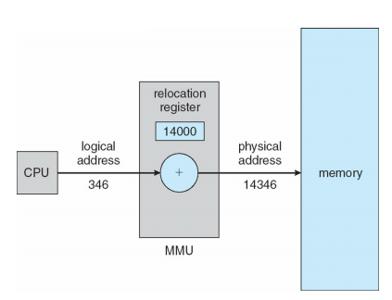
Dynamic relocation using a relocation register

Slide 12
We now have two different types of addresses: logical addresses (in the range 0 to max) and physical addresses(in the range R +0 to R +max for a base value R).
The user program generates only logical addresses and thinks that the process runs in locations 0 to max. However, these logical addresses must be mapped to physical addresses before they are used.

Slide 13
Dynamic Loading
The size of a process has thus been limited to the size of physical memory. To obtain better memory-space utilization, we can use dynamic loading.
With dynamic loading, a routine is not loaded until it is called.
All routines are kept on disk in a relocatable load format.
Dynamic Linking and Shared Libraries
Dynamically linked libraries are system libraries that are linked to user programs when the programs are run
Static linking – system libraries and program code combined by the linker & loader into the binary program image
Dynamic linking –linking postponed until execution time. This feature is usually used with system libraries, such as language subroutine libraries.

Slide 14
With dynamic linking, a stub is included in the image for each library routine reference. The stub is a small piece of code that indicates how to locate the appropriate memory-resident library routine or how to load the library if the routine is not already present.

Slide 15
Swapping
A process can be swapped temporarily out of memory to a backing store, and then brought back into memory for continued execution
Backing store
Roll out, roll in ( Swap out Swap in)
Major part of swap time is transfer time; total transfer time is directly proportional to the amount of memory swapped
System maintains a ready queue

Slide 16
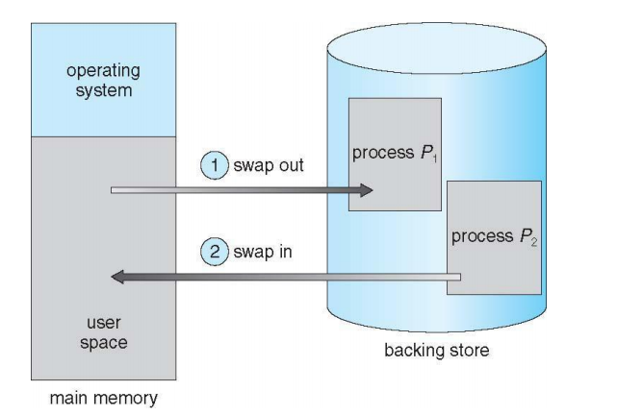
Schematic View of Swapping

Slide 17
Swapping on Mobile Systems
Not typically supported
Flash memory based
Small amount of space
Limited number of write cycles
Poor throughput between flash memory and CPU on mobile platform
Instead use other methods to free memory if low
iOS asks apps to voluntarily relinquish allocated memory
Read-only data thrown out and reloaded from flash if needed
Failure to free can result in termination
Android terminates apps if low free memory, but first writes application state to flash for fast restart

Slide 18
Contiguous Allocation
Main memory must support both OS and user processes
Limited resource, must allocate efficiently
Contiguous allocation is one early method
Main memory usually into two partitions:
Resident operating system, usually held in low memory with interrupt vector
User processes then held in high memory

Slide 19
Contiguous Allocation (Cont.)
Relocation registers used to protect user processes from each other, and from changing operating-system code and data
Base register
Limit register
MMU
Can then allow actions such as kernel code being transient and kernel changing size

Slide 20
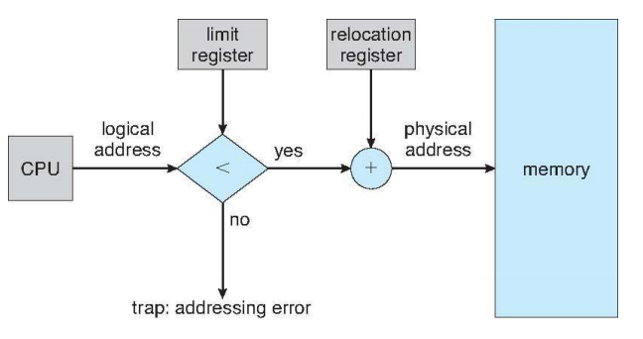
Hardware Support for Relocation and Limit Registers

Slide 21
MEMORY ALLOCATION
One of the simplest methods for allocating memory is to divide memory into several fixed-sized partitions.
Each partition may contain exactly one process - Multiple-partition allocation
Degree of multiprogramming limited by number of partitions
Variable-partition sizes for efficiency (sized to a given process’ needs)
Hole – block of available memory; holes of various sizes are scattered throughout memory
Initially, all memory is available for user processes and is considered one large block

Slide 22
Dynamic Storage-Allocation Problem
How to satisfy a request of size n from a list of free holes?
First-fit: Allocate the first hole that is big enough
Best-fit: Allocate the smallest hole that is big enough
Worst-fit: Allocate the largest hole.
First-fit and best-fit better than worst-fit in terms of speed and storage utilization

Slide 23
Fragmentation
External Fragmentation:
Total memory space exists to satisfy a request, but it is not contiguous
Internal Fragmentation:
Allocated memory may be slightly larger than requested memory

Slide 24
Fragmentation (Cont.)
Reduce external fragmentation by compaction
Shuffle memory contents to place all free memory together in one large block
Compaction is possible only if relocation is dynamic, and is done at execution time

Slide 25
Paging
Physical address space of a process can be noncontiguous; process is allocated physical memory whenever the latter is available
Avoids external fragmentation
Avoids problem of varying sized memory chunks
Divide physical memory into fixed-sized blocks called frames
Size is power of 2, between 512 bytes and 16 Mbytes
Divide logical memory into blocks of same size called pages

Slide 26
Paging
Keep track of all free frames
To run a program of size N pages, need to find N free frames and load program
Set up a page table to translate logical to physical addresses

Slide 27

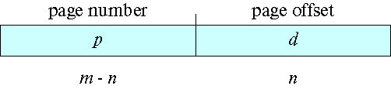
Cont..
Address generated by CPU is divided into:
Page number (p) – used as an index into a page table which contains base address of each page in physical memory
Page offset (d) – combined with base address to define the physical memory address that is sent to the memory unit
For given logical address space 2^{m} and page size 2^{n}

Slide 28
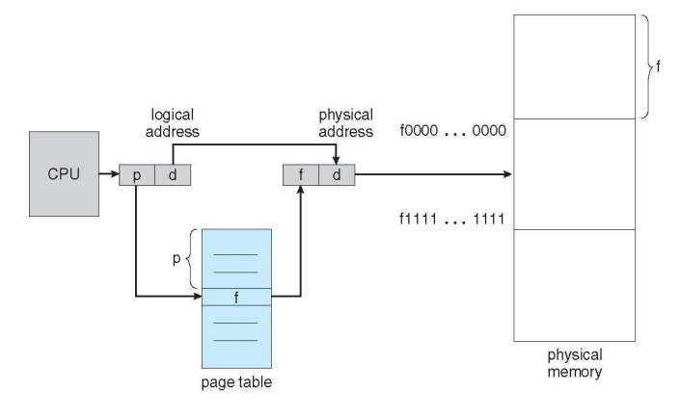
Paging Hardware

Slide 29
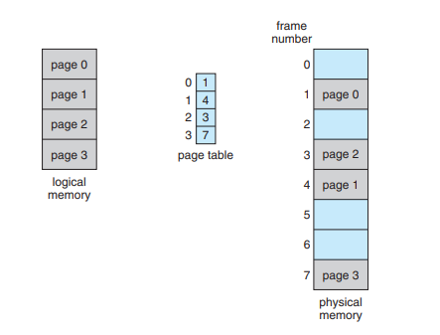
Paging model of logical and physical memory

Slide 30
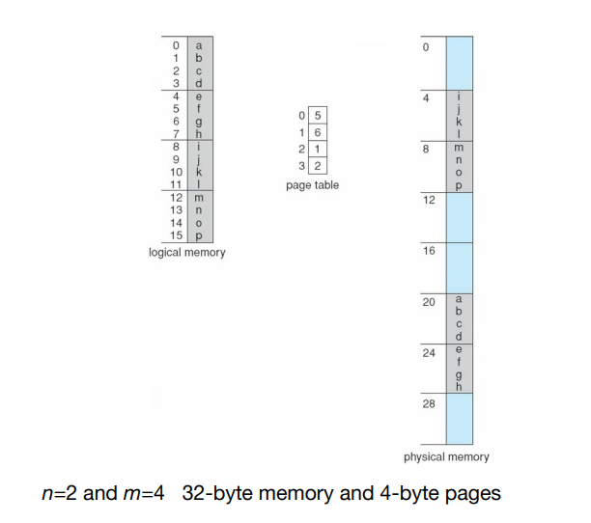
Cont..
Indexing into the page table, we find that page 0 is in frame 5. Thus, logical address 0 maps to physical address 20 [= (5 × 4) + 0]. Logical address 3 (page 0, offset 3) maps to physical address 23 [= (5 × 4) + 3

Slide 31

Free Frames
Before allocation
After allocation

Slide 32
Hardware Implementation of Page Table
Page table is kept in main memory
Page-table base register (PTBR) points to the page table
Page-table length register (PTLR) indicates size of the page table
In this scheme every data/instruction access requires two memory accesses
One for the page table and one for the data / instruction

Slide 33
Translation Look-Aside Buffer
The two-memory access problem can be solved by the use of a special fast-lookup hardware cache called translation look-aside buffers (TLBs) (also called associative memory)
TLBs typically small (64 to 1,024 entries)
On a TLB miss, value is loaded into the TLB for faster access next time
Replacement policies must be considered
Some entries can be write down for permanent fast access
Some TLBs store address-space identifiers (ASIDs) in each TLB entry

Slide 34

Paging Hardware With TLB

Slide 35
Effective Access Time
Hit ratio – percentage of times that a page number is found in the TLB
An 80% hit ratio means that we find the desired page number in the TLB 80% of the time.
Suppose that it takes 10 nanoseconds to access memory.
If we find the desired page in TLB then a mapped-memory access take 10 nanoseconds
Otherwise we need two memory access so it is 20 nanoseconds
Effective Access Time (EAT)
EAT = 0.80 x 10 + 0.20 x 20 = 12 nanoseconds
implying 20% slowdown in access time

Slide 36
Memory Protection
Memory protection implemented by associating protection bit with each frame to indicate if access is allowed
Valid-invalid bit attached to each entry in the page table:
“valid” indicates that the associated page is in the process’ logical address space, and is thus a legal page
“invalid” indicates that the page is not in the process’ logical address space
Or use page-table length register (PTLR)

Slide 37

Valid (v) or Invalid (i) Bit In A Page Table

Slide 38
Shared Pages
Shared code
One copy of read-only (reentrant) code shared among processes (i.e., text editors, compilers, window systems)
Private code and data
Each process keeps a separate copy of the code and data
The pages for the private code and data can appear anywhere in the logical address space

Slide 39

Shared Pages Example

Slide 40
Structure of the Page Table
Memory structures for paging can get huge using straight-forward methods
Consider a 32-bit logical address space as on modern computers
Page size of 1 KB (2¹⁰)
Page table would have 1 million entries (2³² / 2¹⁰)

Slide 41
Cont..
If each entry is 4 bytes ➔ each process requires 16 MB of physical address space for the page table alone
Don’t want to allocate that contiguously in main memory
One simple solution is to divide the page table into smaller units
Hierarchical Paging
Hashed Page Tables
Inverted Page Tables

Slide 42

Hierarchical Page Tables

Slide 43
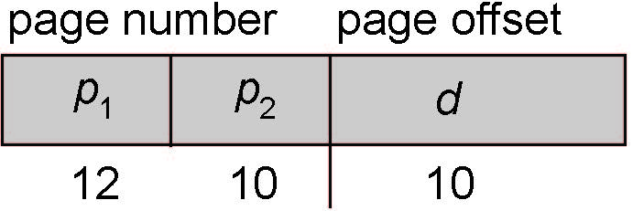
Two-Level Paging Example
A logical address (on 32-bit machine with 1K page size) is divided into:
a page number consisting of 22 bits
a page offset consisting of 10 bits
Since the page table is paged, the page number is further divided into:
a 12-bit page number
a 10-bit page offset
Thus, a logical address is as follows:
where p₁ is an index into the outer page table, and p₂ is the displacement within the page of the inner page table
Known as forward-mapped page table

Slide 44

Address-Translation Scheme

Slide 45
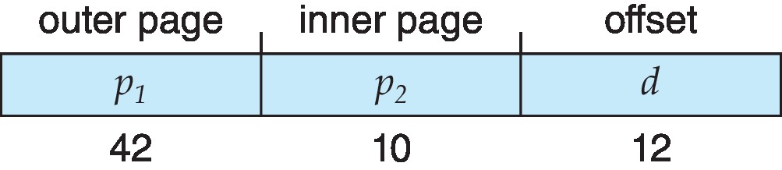
64-bit Logical Address Space
Even two-level paging scheme not sufficient
If page size is 4 KB (2¹²)
Then page table has 2⁵² entries
If two level scheme, inner page tables could be 2¹⁰ 4-byte entries
Address would look like
Outer page table has 2⁴² entries or 2⁴⁴ bytes
One solution is to add a 2nd outer page table
But in the following example the 2nd outer page table is still 2³⁴ bytes in size
And possibly 4 memory access to get to one physical memory location

Slide 46


Three-level Paging Scheme

Slide 47
Hashed Page Tables
Used in architecture with address spaces > 32 bits
The virtual page number is hashed into a page table
This page table contains a chain of elements hashing to the same location
Each element contains
The virtual page number
The value of the mapped page frame
A pointer to the next element
Virtual page numbers are compared in this chain searching for a match
If a match is found, the corresponding physical frame is extracted

Slide 48
Cont..
Variation for 64-bit addresses is clustered page tables
Similar to hashed but each entry refers to several pages (such as 16) rather than 1
Especially useful for sparse address spaces (where memory references are non-contiguous and scattered)

Slide 49

Hashed Page Table

Slide 50
Inverted Page Table
Rather than having each process keep a page table and track of all possible logical pages, track all physical pages
One entry for each real page of memory
Entry consists of the virtual address of the page stored in that real memory location, with information about the process that owns that page
Decreases memory needed to store each page table, but increases time needed to search the table when a page reference occurs
Use hash table to limit the search to one (or at most a few) page-table entries
TLB can accelerate access
But how to implement shared memory?
One mapping of a virtual address to the shared physical address

Slide 51

Inverted Page Table Architecture

Slide 52
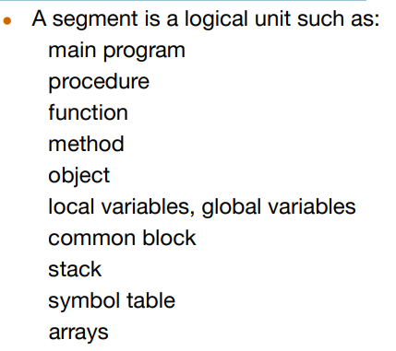
Segmentation
Memory-management scheme that supports user view of memory
A program is a collection of segments

Slide 53
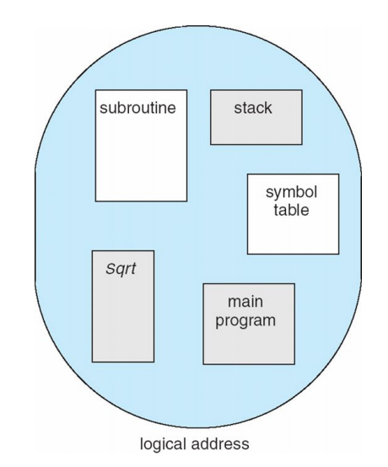
User’s View of a Program

Slide 54
Cont..
Elements within a segment are identified by their offset from the beginning of the segment
Each segment has a name and a length.
The addresses specify both the segment name and the offset within the segment.
For simplicity of implementation, segments are numbered and are referred to by a segment number, rather than by a segment name.

Slide 55
Cont..
A C compiler might create separate segments for the following:
1. The code
2. Global variables
3. The heap, from which memory is allocated
4. The stacks used by each thread
5. The standard C library

Slide 56
Segmentation Architecture
Logical address consists of a two tuple:
<segment-number, offset>
Segment table
base
limit
Segment-table base register (STBR) points to the segment table’s location in memory
Segment-table length register (STLR) indicates number of segments used by a program; segment number s is legal if s < STLR

Slide 57
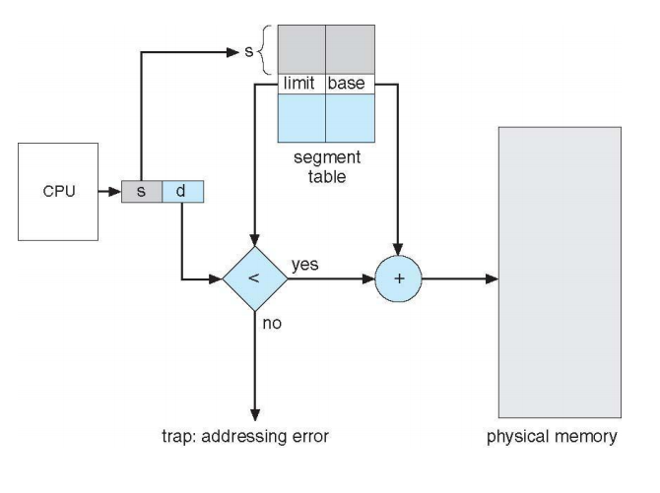
Segmentation Hardware

Slide 58
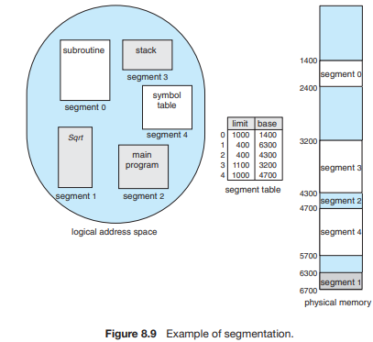
Example of Segmentation
Thus, a reference to byte 53 of segment 2 is mapped onto location 4300 + 53 = 4353.

Slide 59
Thank You

